Slide 1
PREDICTING THE SUPERCOMPUTER USAGE FOR NSF AWARDED PROJECTS
A KAGGLE CONTEST SUBMISSION FOR STAT 8730, UNIVERSITY OF NEBRASKA AT OMAHA (FALL 2022)
BLESSING E. OLADOKUN

Slide 2
DATA EXPLORATION
The train dataset was firstly explored by eye-balling the spreadsheet in Excel. From this process, I was able to identify the variables that would be ultimately useful in the model building and those I need to eliminate. But, that was just a first check.
I also explored some of the quantitative variables using a Correlation plot, to find out predictors that may have a high correlation with each other. The result of one of my correlation plot is presented in the following slide…
The dataset was also explored by using the summary() function in R. This summarized all the variables at a glance. The result of the summary helped identify the class for each of the variables; the levels of the categorical variables; the distribution of the quantitative variables.
The result from the summary also presented the opportunity to identify redundant variables in the dataset; i.e., variables with zero variance and categorical variables that are not useful to the analysis.

Slide 3
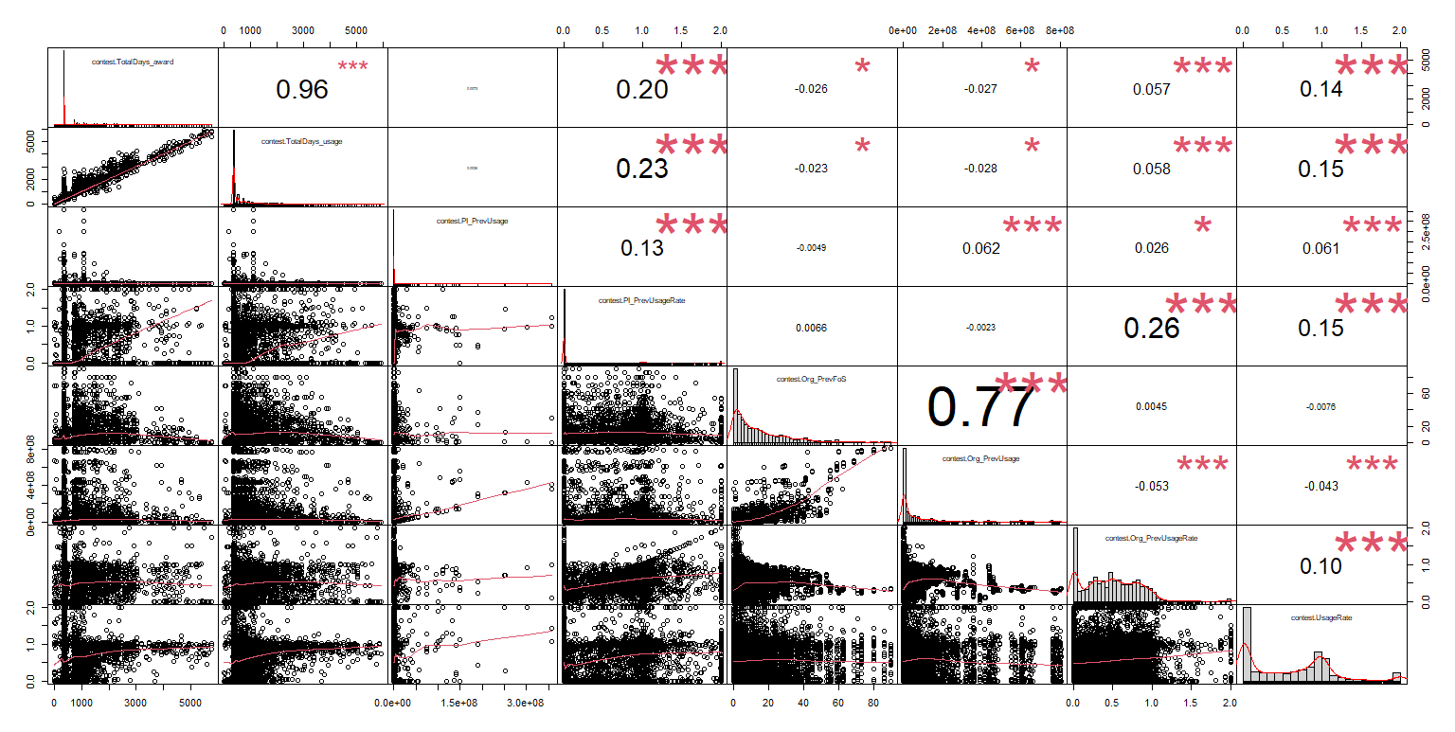
DATA EXPLORATION

Slide 4
VARIABLE SELECTION
Following exploration of the dataset, 91 variables were firstly selected as a new data frame subset for my analysis. This first subset consists of 90 predictors, and the response variable.
For this project, no new variable was created.

Slide 5
VALIDATION APPROACH
To train my model, I used the caret package in R.
The caret package has an in-built function that allowed for several validation approaches. The function was trainControl.
In the trainControl function, I used the “repeatedcv” approach; specifically, a 10-fold cross-validation approach, repeated 5 times.
An overview of my R-code on how the function was used is presented in the next slide…

Slide 6
R-CODE FOR VALIDATION APPROACH
library(caret)
train_cont<- trainControl(method = "repeatedcv",
number = 10,
repeats = 5,
search = "random",
verboseIter = TRUE)

Slide 7
METHOD SELECTION
The caret package had function to also build lots of predictive models I could consider for the project. The train function.
The train function is capable of building tons of models (linear models, neural network models, Bayesian models, Additive models, regularized models, and even tree models)…with a very simple code presented below.
elasticNet.contest<- train(contest.UsageRate ~ .,
data = contestData,
method = "glmnet",
preProcess = c("center", "scale"),
tuneLength = 10,
trControl = train_cont)

Slide 8
METHOD SELECTION
Using the train function, the trainControl previously defined was called in. So, each model was preformed under 10-fold cross-validation with 5-repeats.
All predictive models built for this contest was done using the two functions from caret; by just changing the method to the method of my choice per time.
Worth of note is that: The train function had the feature to pre-process the data itself. So, there was very little work needed in creating dummy variables, as the pre-process feature recognized the categorical variables and created hidden dummy variables for the models.
Also, it is important to note that some of methods require other libraries to successfully build the model with the train function from caret.
A list of all the models that can be built with the train function in the caret package can be found via this link: http://topepo.github.io/caret/train-models-by-tag.html#Linear_Regression

Slide 9
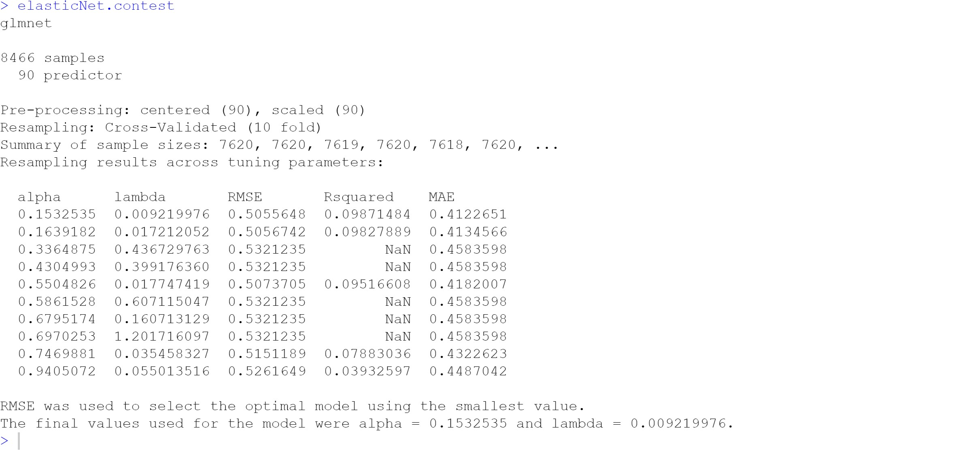
PARAMETER TUNING
The train function also had the feature to intuitively tune parameters of each of the models.
10 parameter tuning was used for each of the models that required parameter tuning.
After 5-repeated 10-cross-validation, the function automatically picks the best parameter, based on the RMSE. That is, the parameter where the lowest RMSE is obtained is chosen to fit the overall train data-set.

Slide 10
RESULTS
Model | Parameter(s) | Train RMSE | Test RMSE
ElasticNet (glmnet) | Alpha =0.1533 Lambda=0.0092 | 0.5019 | 0.4529
Linear Regression (lm) | Intercept=TRUE | 0.5014 | 0.4530
Principal Component Regression (pcr) | ncomp=87 | 0.5014 | 0.4535
Model | Parameter(s) | Train RMSE | Test RMSE
Ridge Regression (ridge) | Lambda=0.0106 | 0.5014 | 0.4540
Spike and Slab Regression (spikeslab) | nVar=62 | 0.5016 | 0.4538
Neural Net (nnet) | Size of hidden layer=7 Decay=7.4684 | 0.5003 | 0.4512

Slide 11
RESULTS
Model | Parameter(s) | Train RMSE | Test RMSE
Neural Network with feature extraction (pca_nnet) | Size of hidden layer=1 Decay=0.0885 | 0.4968 | 0.45008
Deep Neural Network (dnn) | Layer1=15 Layer2=14 Layer3=4 | 0.5379 | 0.4665
Model Averaged Neural Network (avNNet) | Size of hidden layer=2 Decay=0.0728 | 0.4915 | 0.4515
Model | Parameter(s) | Train RMSE | Test RMSE
Extreme Gradient Boosting (xgboost) | Nrounds=228, maxdepth=6, eta=0.1394… | 0.4423 | 0.4491
General Additive model with Regression splines (bam) | None | 0.5080 | 0.4532
Gaussian Process (gaussprLinear) | None | 0.5014 | 0.4548

Slide 12
RESULTS
Model | Parameter(s) | Train RMSE | Test RMSE
Projection Pursuit Regression (ppr) | nterms=3 | 0.4970 | 0.4691
Bag MARS using gCV Pruning (bagEarthGCV) | degree=1 | 0.4938 | 0.44623
Extreme Gradient Boosting (xgDart) | Nrounds=680, maxdepth=4, eta=0.2739… | 0.4889 | 0.4489

Slide 13
OTHER METHODS USED
There were quite some other methods used in my prediction trial, but not included above, because the RMSE’s were not an improvement over what I had previously or I STOPPED the computation as it was taking too long a time to fit the model.
This includes:
Lasso regression
Linear regression with Stepwise selection
Logic regression
Model Tree
Cubist model
Model Tree
Non-convex penalized quantile regression
Non-negative least square
Partial least square
Penalized regression
Quantile regression with LASSO penalty
Relevance vector machines with Linear Kernel
Robust linear model
Bayesian regularized neural network
Quantile regression neural network
Regularized random forest
General additive model using LOESS

Slide 14
FINDINGS AND SUMMARY
The ‘Bag MARS using gCV Pruning’ was my best model, as it gave the lowest RMSE on the test data-set.
The other models with very good RMSE on the test data-set were: Extreme Gradient Boosting, Neural Network, and Neural Network with feature selection.
My final note is that: The computation time for some of the models can be breathtaking, especially with large folds cross-validation.

